Slide 1
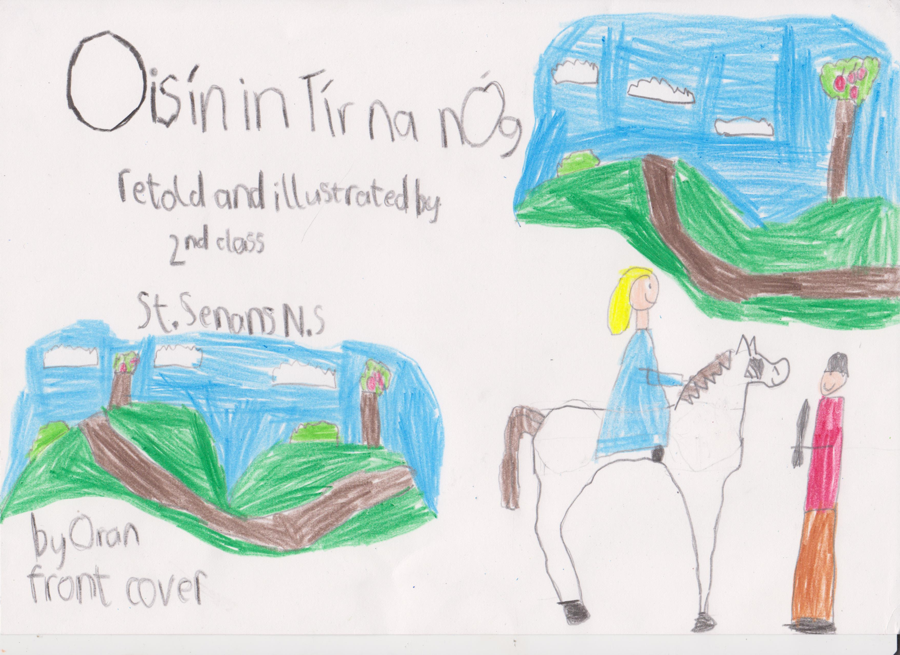

Slide 2
These are the characters from Oisín in Tír na nÓg.
There is Niamh Cinn Óir, the Fianna, the magical horse and Oisín.
Fionn was the leader of the Fianna. Fionn means 'fair-haired'.
Teagan

Slide 3
Long ago in Ireland there lived a great warrior called Oisín.
Kate

Slide 4
One morning Oisín was out hunting.
He was with his father, Fionn Mac Cumhaill, and the men of the Fianna.
Oisín heard a sound close by.
William

Slide 5
Oisín saw a young woman riding a white horse.
Her hair was golden and shone in the sun like a crown.
She wore a beautiful blue dress with stars all over it.
Ellen

Slide 6
She said “My name is Niamh Cinn Óir, my father is the king of Tír na nÓg.
It is a magical land where no one grows old.Oisín I want you to go there with me.”
Oisín Fleming

Slide 7
Niamh held out her hand and Oisín took it.
He was sad to leave his father and friends, but he wanted to go to Tír na nÓg.
Rhiann

Slide 8
0isín got up on the fine white horse with Niamh.
They galloped across the silver seas into the magical land of Tír na nÓg.
Matthew

Slide 9
Oisín loved his new home in Tír na nÓg, a land where nobody ever grew old.
But, as time went by, he began to miss Ireland.
Niamh

Slide 10
Oisín spoke to Niamh,
''I miss my friends and family in Ireland. Why don't we visit Ireland together?''
But Niamh could not leave Tír na nÓg. She begged Oisín not to go.
Alannah

Slide 11
In the end, Niamh agreed.
“Take my magical white horse,” she told Oisín.Do not get off this horse, if your feet touch the ground, you will never be able to return to Tír na nÓg!
Emily

Slide 12
Oisín promised to stay on the horse and come back soon.
Niamh cried as she watched her horse carry Oisín across the hills and away from
Tír na nÓg.
Oisín Byrne

Slide 13
When he got back to Ireland it was much different.
The place where his father’s great hall had been was now a rocky hill covered in weeds and wild blackberry bushes.
Feidhlim

Slide 14
Oisín rode over to some men who were trying to move a huge rock from a field.
“My name is Oisín,son of Fionn Mac Cumhaill. Where can I find him and his warriors, the Fianna?” he asked.
Brian

Slide 15
The men stared at Oisín. He was the biggest and strongest man they had ever seen.
One of them spoke,
“I have heard of the Fianna. They were great warriors, but they died about 300 years ago”.
Aoife

Slide 16
Oisín felt very sad. He had been in Tír na nÓg for just three years, but time was different there.
Oisín was still a young man, even though 300 years had passed in Ireland.
Jason

Slide 17
Oisín leaned over to use his strength to help the men move the huge rock.
The rock began to move, but Oisín lost his balance and fell from the magical white horse.
Summer

Slide 18
The moment Oisín touched the ground he became a very old man.
The magical horse galloped away and Oisín knew he would never return to Niamh and Tír na nÓg.
Lexi

Slide 19
The men carried Oisín to their village and looked after him .
Oisín told them all about his life in Tír na nÓg with Niamh.
He told them many stories about the Fianna and his father,Fionn Mac Cumhaill.
Emma

Slide 20
The stories of Fionn and the Fianna have been passed down through generations.
If you enjoyed our version of this famous myth you can check it out on the school website.
www.stsenans.weebly.com
Rubi
By Patrick

