Slide 1
My Indian Project
Completed by Lauren....

Slide 2
Famous Indian people
Mahatma Ghandi is a famous Indian man who fought for independence in India. He went on 18 fasts in total and many marches to help fight for independence.
Mother Theresa was a women who believed in God. At the age of 36 she got the call from god to go help the poor people of India. She devoted her
entire life to the people of India. While she was suffering she tried her very
hardest to get food for them.

Slide 3
The Taj Mahal
The Taj Mahal is the most famous tourism spot in India. It is a a building that holds tombs which is called a mausoleum. It is located in the Indian city of Agra. It was built in the 15th Century and the meaning behind Taj Mahal is ‘crown of palaces’
Many scientists worry that the Taj Mahal may be sinking slowly into the Yamuna River.
Nearly 6.9 million people have visited the Taj Mahal in the years of 2018-19

Slide 4
Facts on India
India’s population is over 1.2 billion people.
The capital city is New Delhi.
The national symbol is the Endangered Bengal Tiger.
More than 80% of people are Hindu.
India is a very spiritual country.

Slide 5
Food in India
India is well known for its spices.
A very traditional food dish in India is (roti)a whole wheat flat bread and (Dahl)a lentil based stew Indians have this whether it’s for breakfast, lunch and dinner.
Indian people drink a lot of chai (what we call tea)
Another popular drink is ‘Lassi’. A lassi is a mixture of yoghurt, water, spices and fruit.

Slide 6
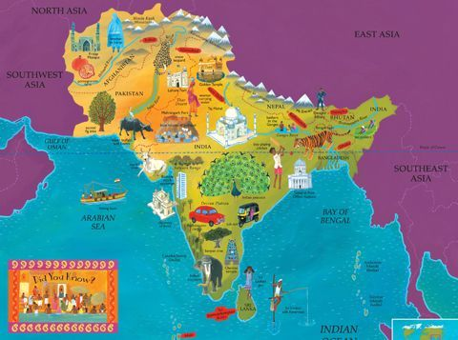
Hope you enjoyed 😁😁

